Slide 1
Teach reading: change lives
Parent workshop: Phonics and early reading at Walsh Memorial Infant School

Slide 2
A love of reading is the biggest indicator of future academic success.
OECD (The Organisation for Economic Co-operation and Development)

Slide 3
Reading at home

Slide 4
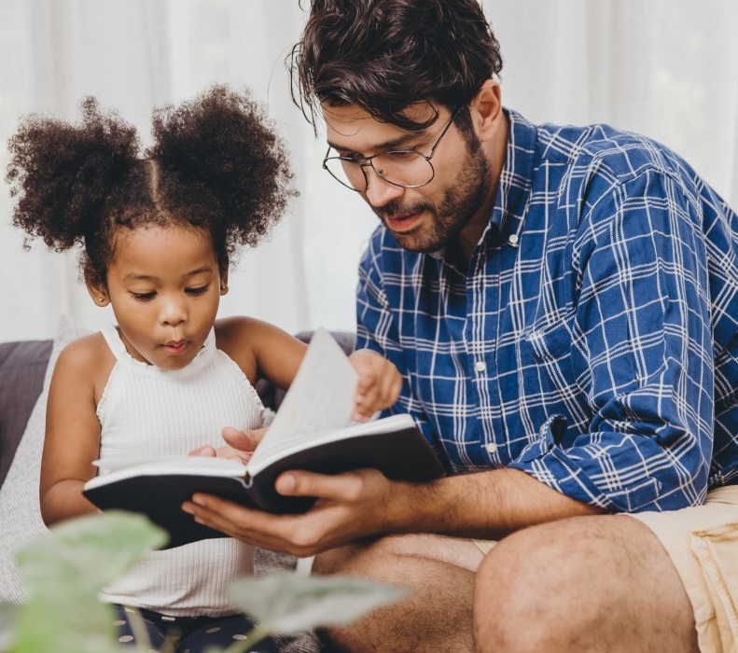
The most important thing you can do is read with your child
Reading a book and chatting about it had a positive impact a year later on children’s ability to…
understand words and sentences
use a wide range of vocabulary
develop listening and comprehension skills
The amount of books children were exposed to by age 6 was a positive predictor of their reading ability two years later.
Parental involvement in the development of children’s reading skills: A five-year longitudinal study (2002) Senechal, M. and Lefvre, J

Slide 5
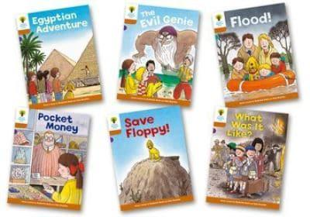
Books going home- 3 new books a week
Sharing book (after Orange level your child will get 2 of these and they will be their main reading books)
Phonetically decodable e reader (until reading at Orange level)
Library book to share with your child

Slide 6
Listening to your child read their phonics book (currently e readers)
These are phonetically decodable books that are matched to your child's phonic knowledge.
The book allocated to your child on a Friday is what they have been reading that week in school.
Your child should be able to read their book without your help.
If they can’t read a word encourage them to sound it out or talk about the tricky part of the word if it’s a tricky word eg. was
Ask questions about what they have read and give them lots of praise.

Slide 7
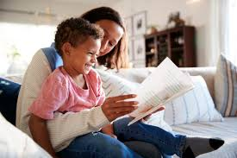
Share with your child
The Sharing book is for YOU to read with your child:
These books are a mixture of decodable and non decodable books within the level they are reading their phonetically decodable book at.
There will be many words they can read but may also contain tricky words or words made up of sounds they have not yet learnt in their phonics lessons which they will need some help to read.
Once your child is at Orange level, they will no longer have the e-reader but will have 2 of these. By this point they should be encouraged to read them independently

Slide 8
Read to your child
The Library book is for YOU to read to your child:
Make the story sound as exciting as you can by changing your voice.
Talk with your child as much as you can:
Predict what they think might happen
Talk about the meaning of new vocabulary
Describe things you see
Talk about the story and characters
Ask your child lots of questions- both literal and inferential

Slide 9
One of the greatest gifts adults can give is to read to children
Carl Sagan

