Slide 1

Teach reading: change lives
Parent workshop: Phonics and early reading at Walsh Memorial Infant School
Notes:
Thanks for coming- I teach in Diamond class and lead English

Slide 2
A love of reading is the biggest indicator of future academic success.
OECD (The Organisation for Economic Co-operation and Development)
Notes:
In our school we prioritise reading as it underpins learning in all other areas of the curriculum.

Slide 3

Phonics

Slide 4
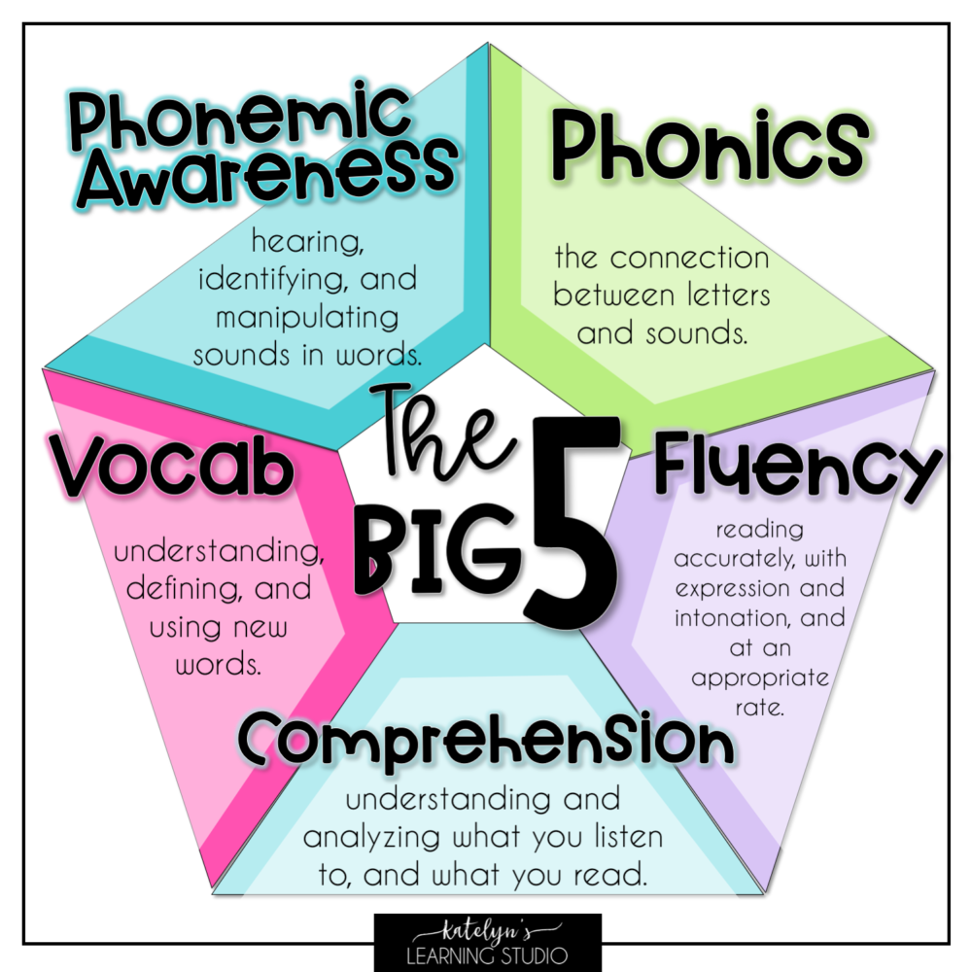

Slide 5
What is phonics?
Phonics is a way of teaching children to read quickly and skilfully. They are taught how to:
recognise the sounds that each individual letter makes;
identify the sounds that different combinations of letters make - such as ‘sh’ or ‘oo’;
and, blend these sounds together from left to right to make a word.
Children can then use this knowledge to ‘de-code’ new words that they hear or see. This is the first important step in learning to read.

Slide 6
Background:
In the latest framework, Ofsted placed a greater emphasis on the teaching of reading, including phonics.
Research shows systematic synthetic phonics is the most effective way to teach children to read quickly and confidently.
Recent guidance on the teaching of early reading led us to look carefully at our phonics provision.

Slide 7
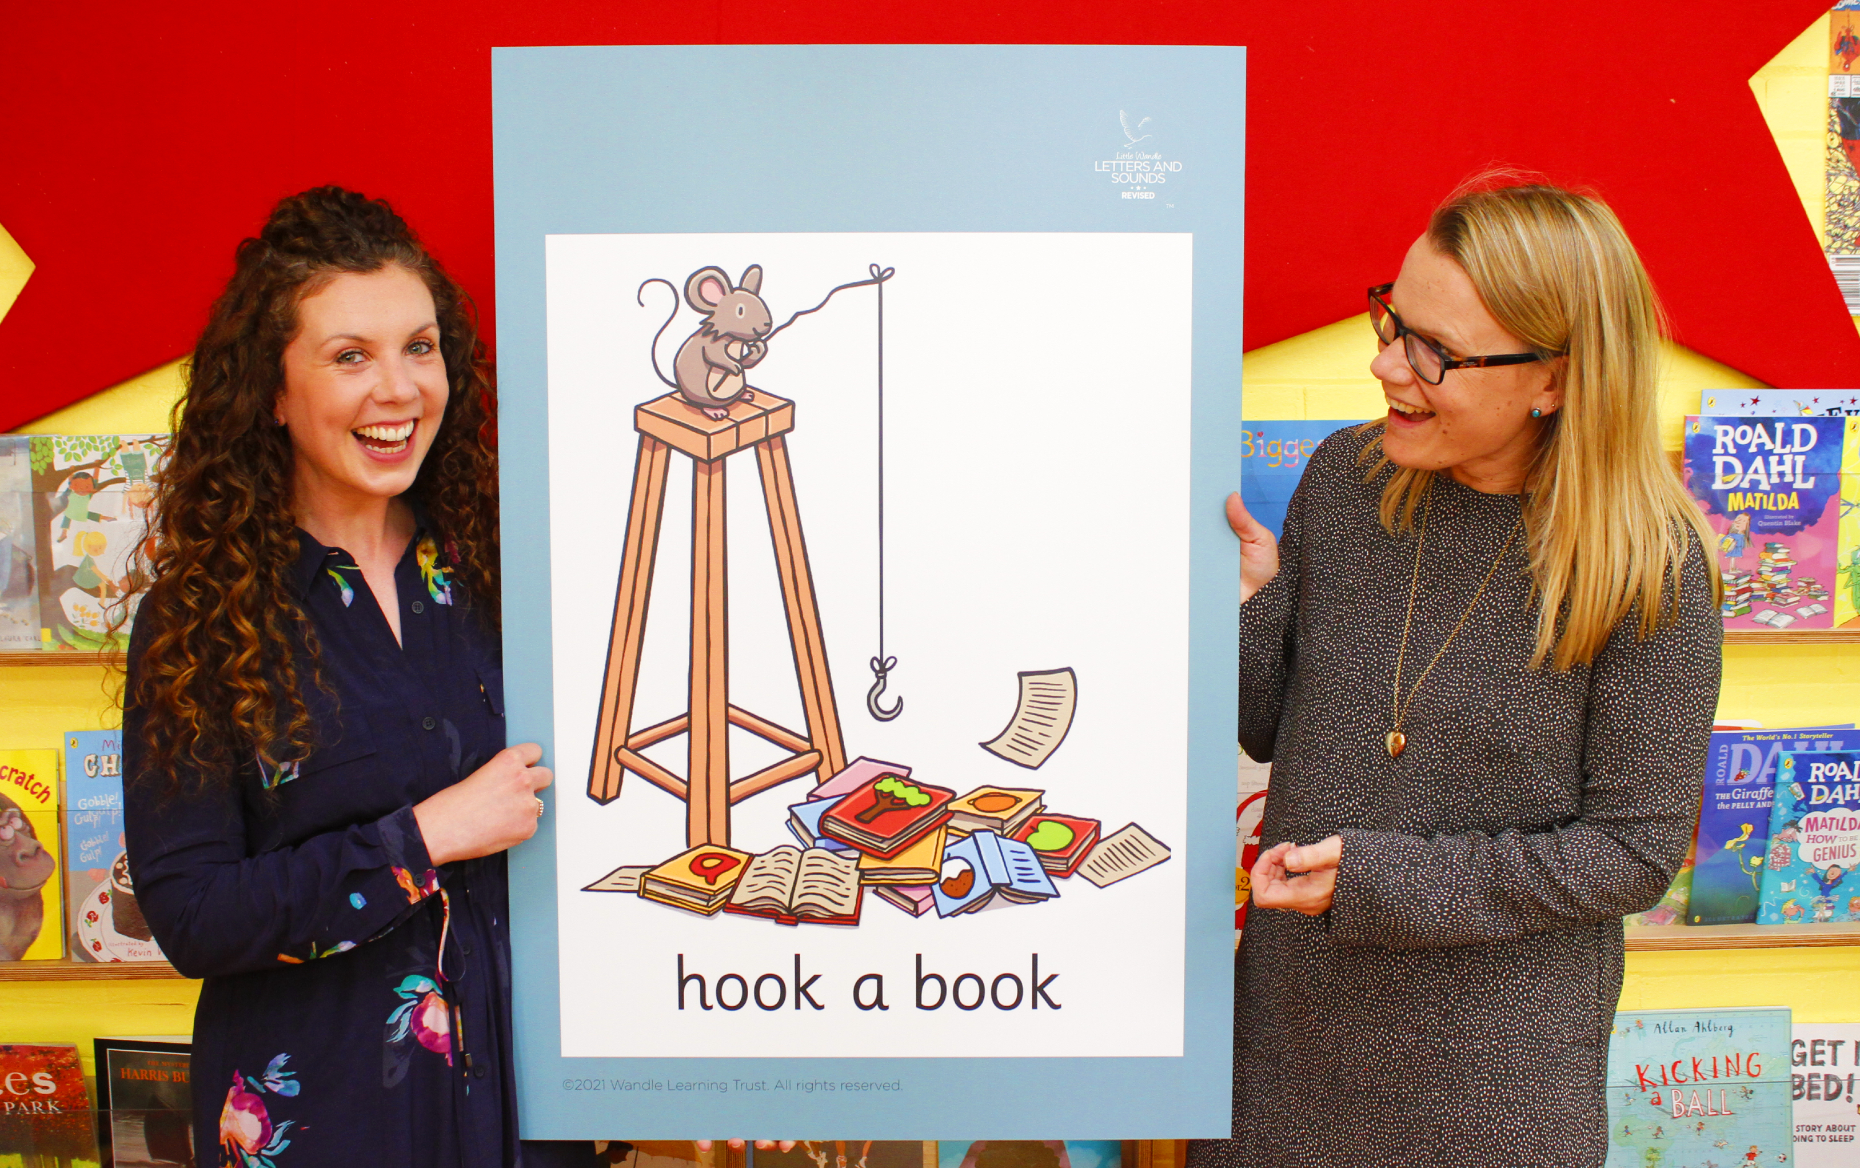
How is Phonics taught at Walsh Infants-
Little Wandle Letters and Sounds Revised
Our school has chosen
Little Wandle Letters and Sounds Revised as our systematic, synthetic phonics (SSP) programme to teach early reading and spelling.
Notes:
All Infant schools have to subscribe to a phonics programme –Little Wandle seems to be the most popular amongst schools.

Slide 8
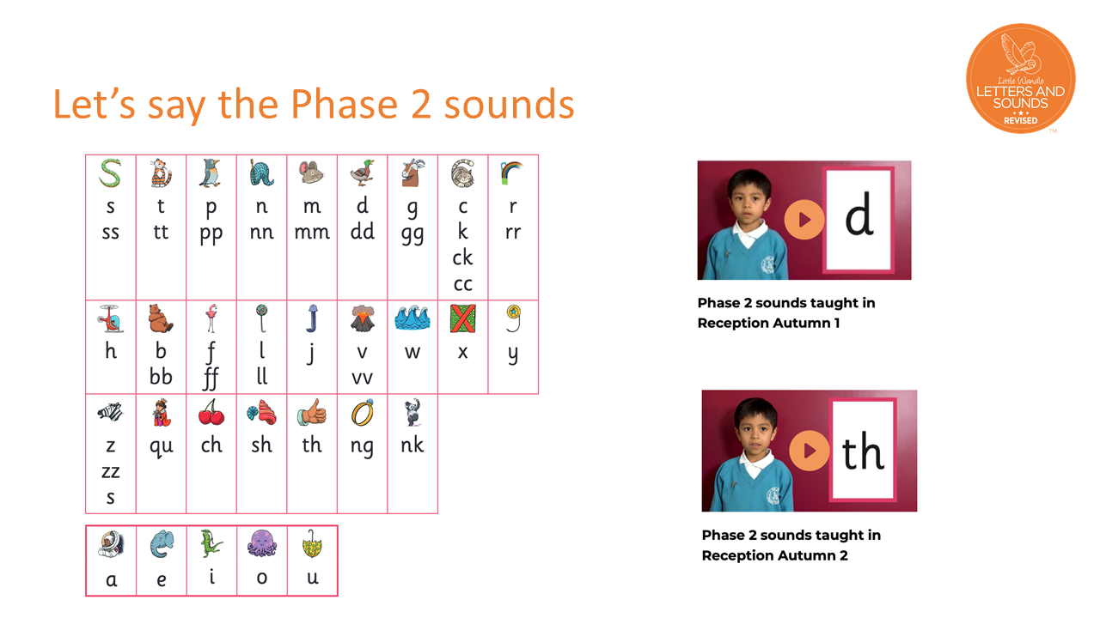

Slide 9
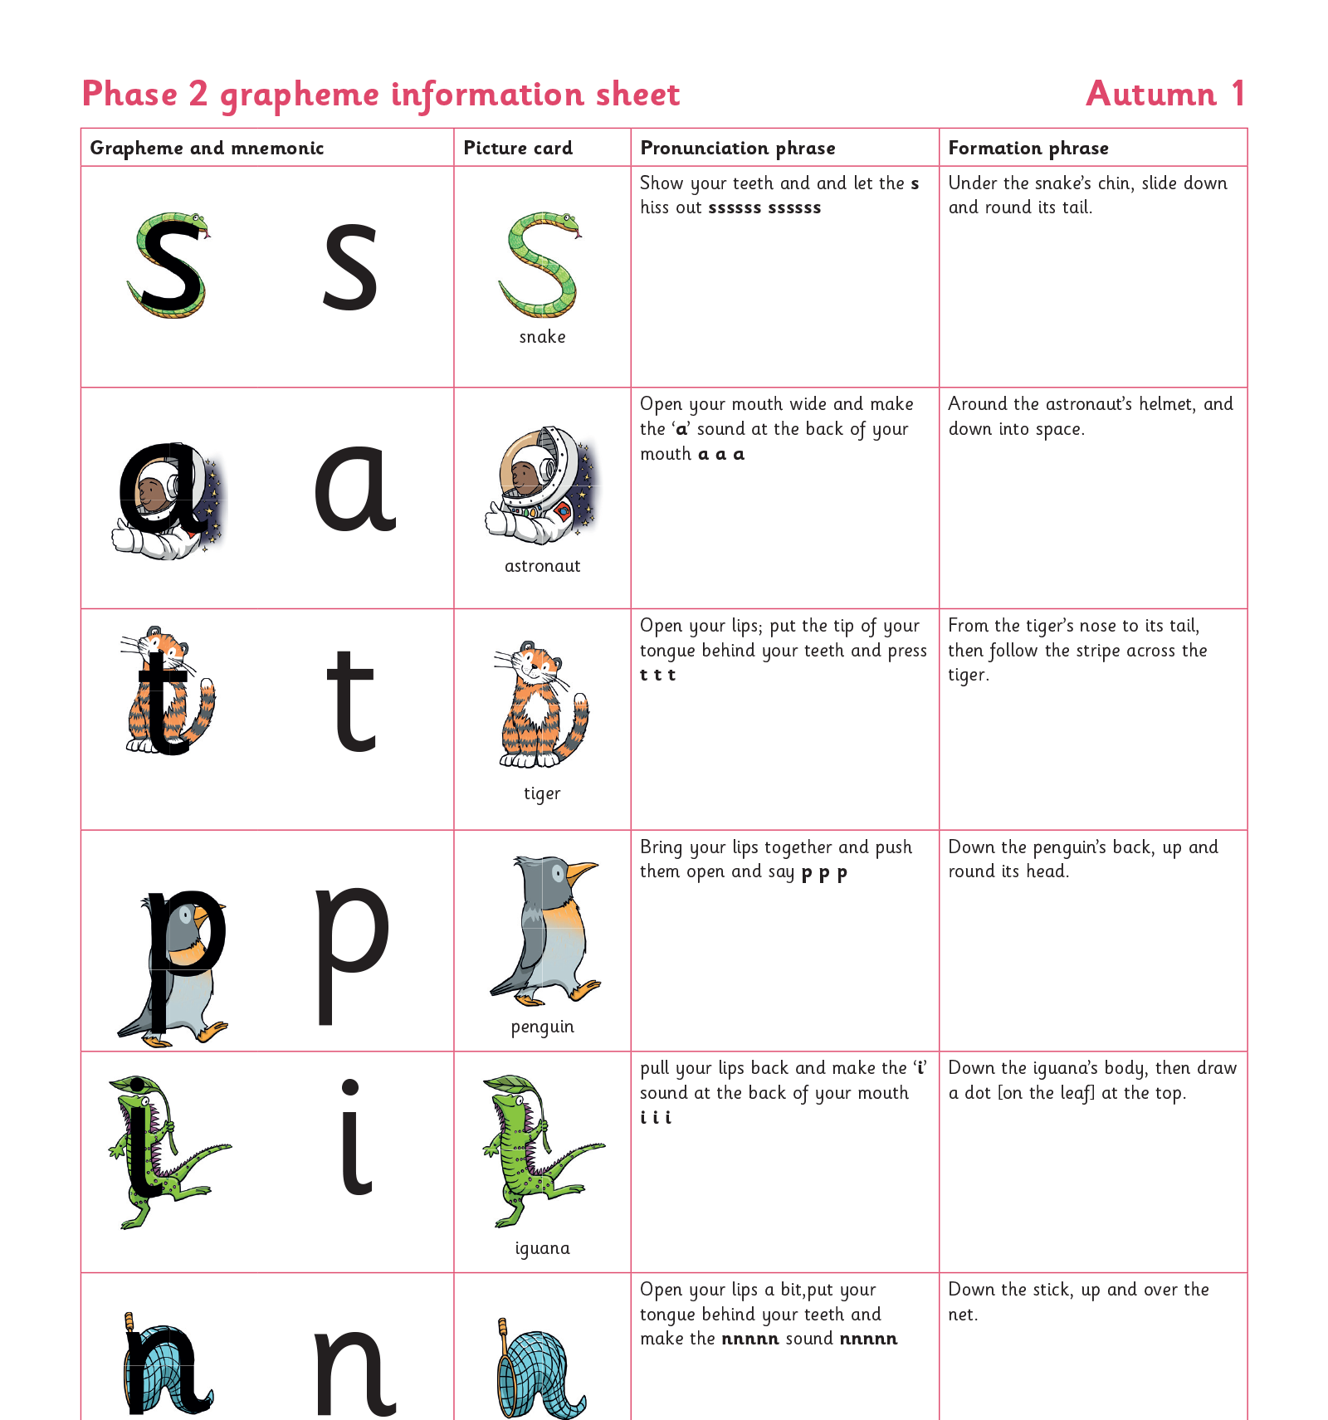
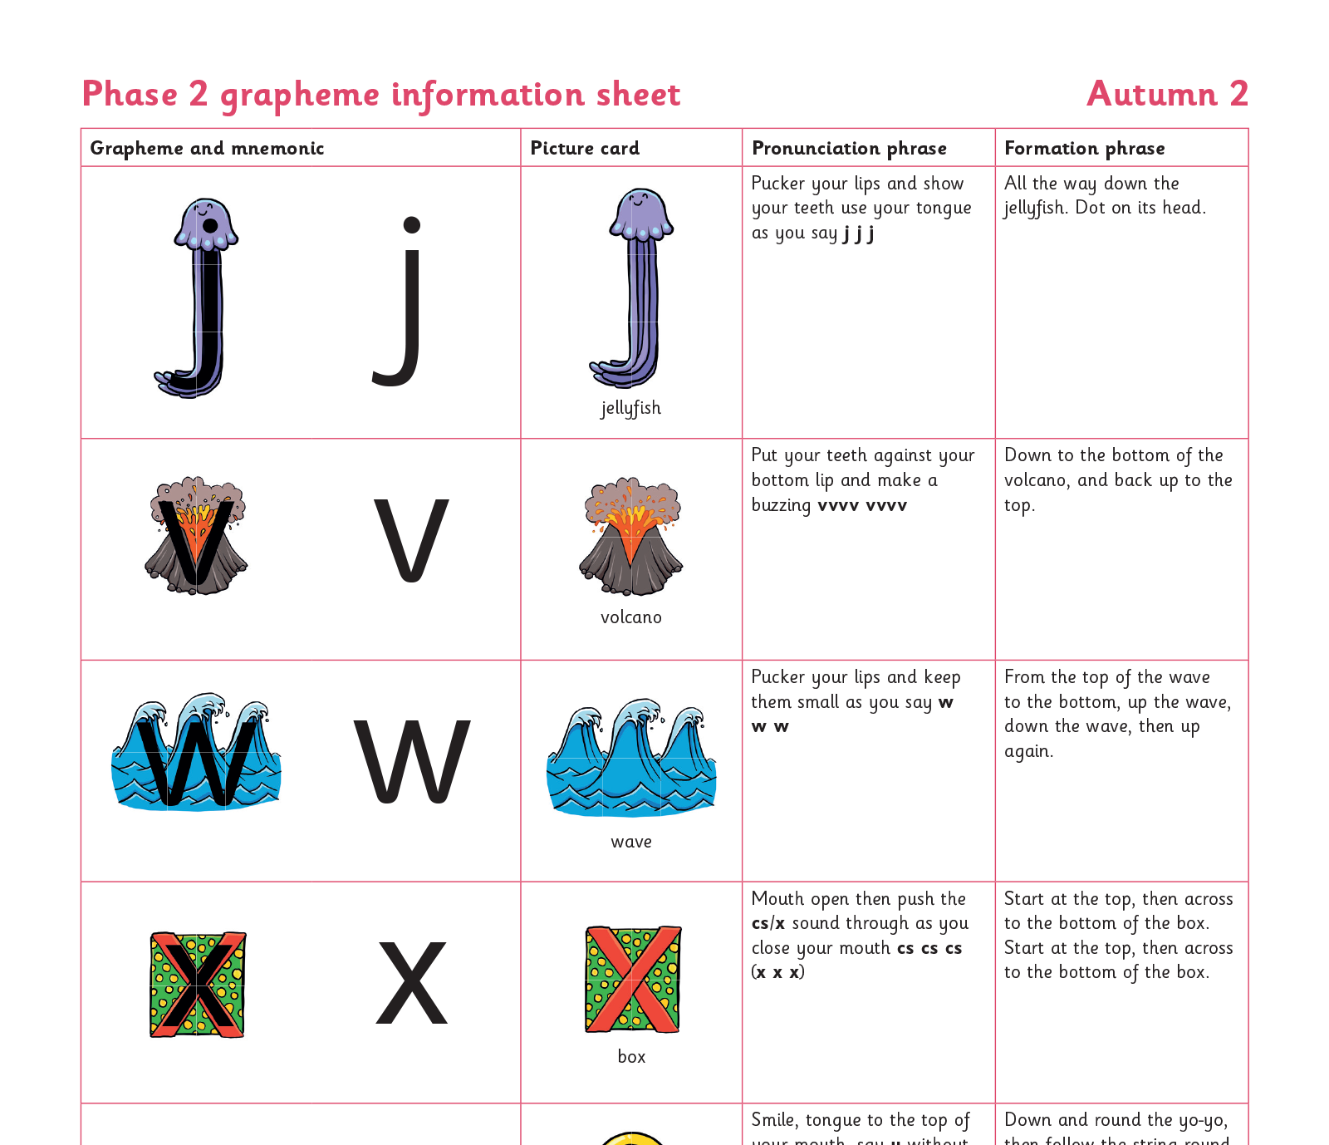
Teaching order
Notes:
Sounds (phonemes) are taught in a specific order
SATPIN first- once a child knows just these sounds they can begin reading and spelling words made up of these eg. Sit, pat, tin etc

Slide 10
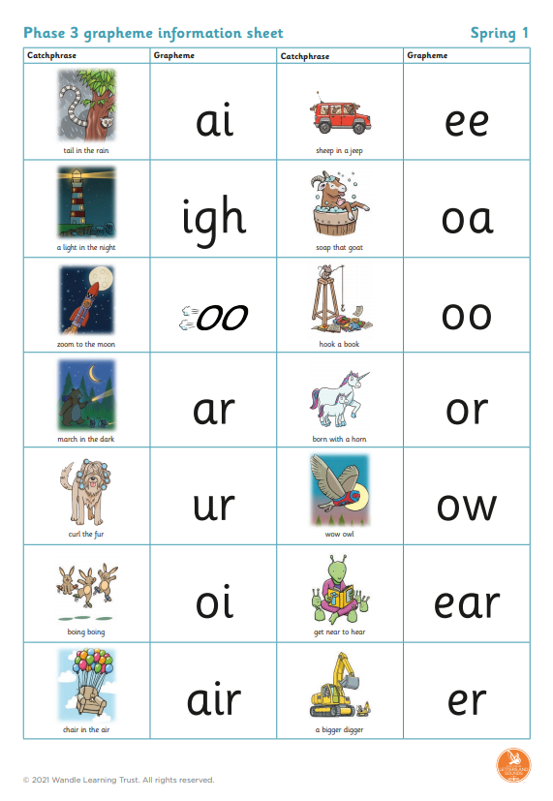
The sounds are introduced in an order that allows a large number of words to be read and written from an early stage.
The pace of teaching will be fast. Children who do not grasp the learning in the lesson will be given extra tuition to enable them to keep up. It is vitally important that the learning is reinforced at home by reading regularly with an adult and revising the parent sheet that we will send out each week.
Phase 1 – 4- Reception
Phase 5 (30 weeks) – Year 1 (completed before the phonics screening check)
Phase 6 (30 weeks) – Year 2
Notes:
After the sounds for the individual letters of the alphabet have been taught, we move onto digraphs and trigraphs in the Spring term of Reception. By the end of Reception children should be able to write simple sentences that can be read by an adult often without the child’s help. Many words may not be spelt correctly as the children have only learnt one way to make each sound eg. you can see in this sentence a child has made phonetically plausible attempts at spelling words using the sounds that they currently know. The children have sound mats like these in lessons which they use the help them become more independent writers.

Slide 11
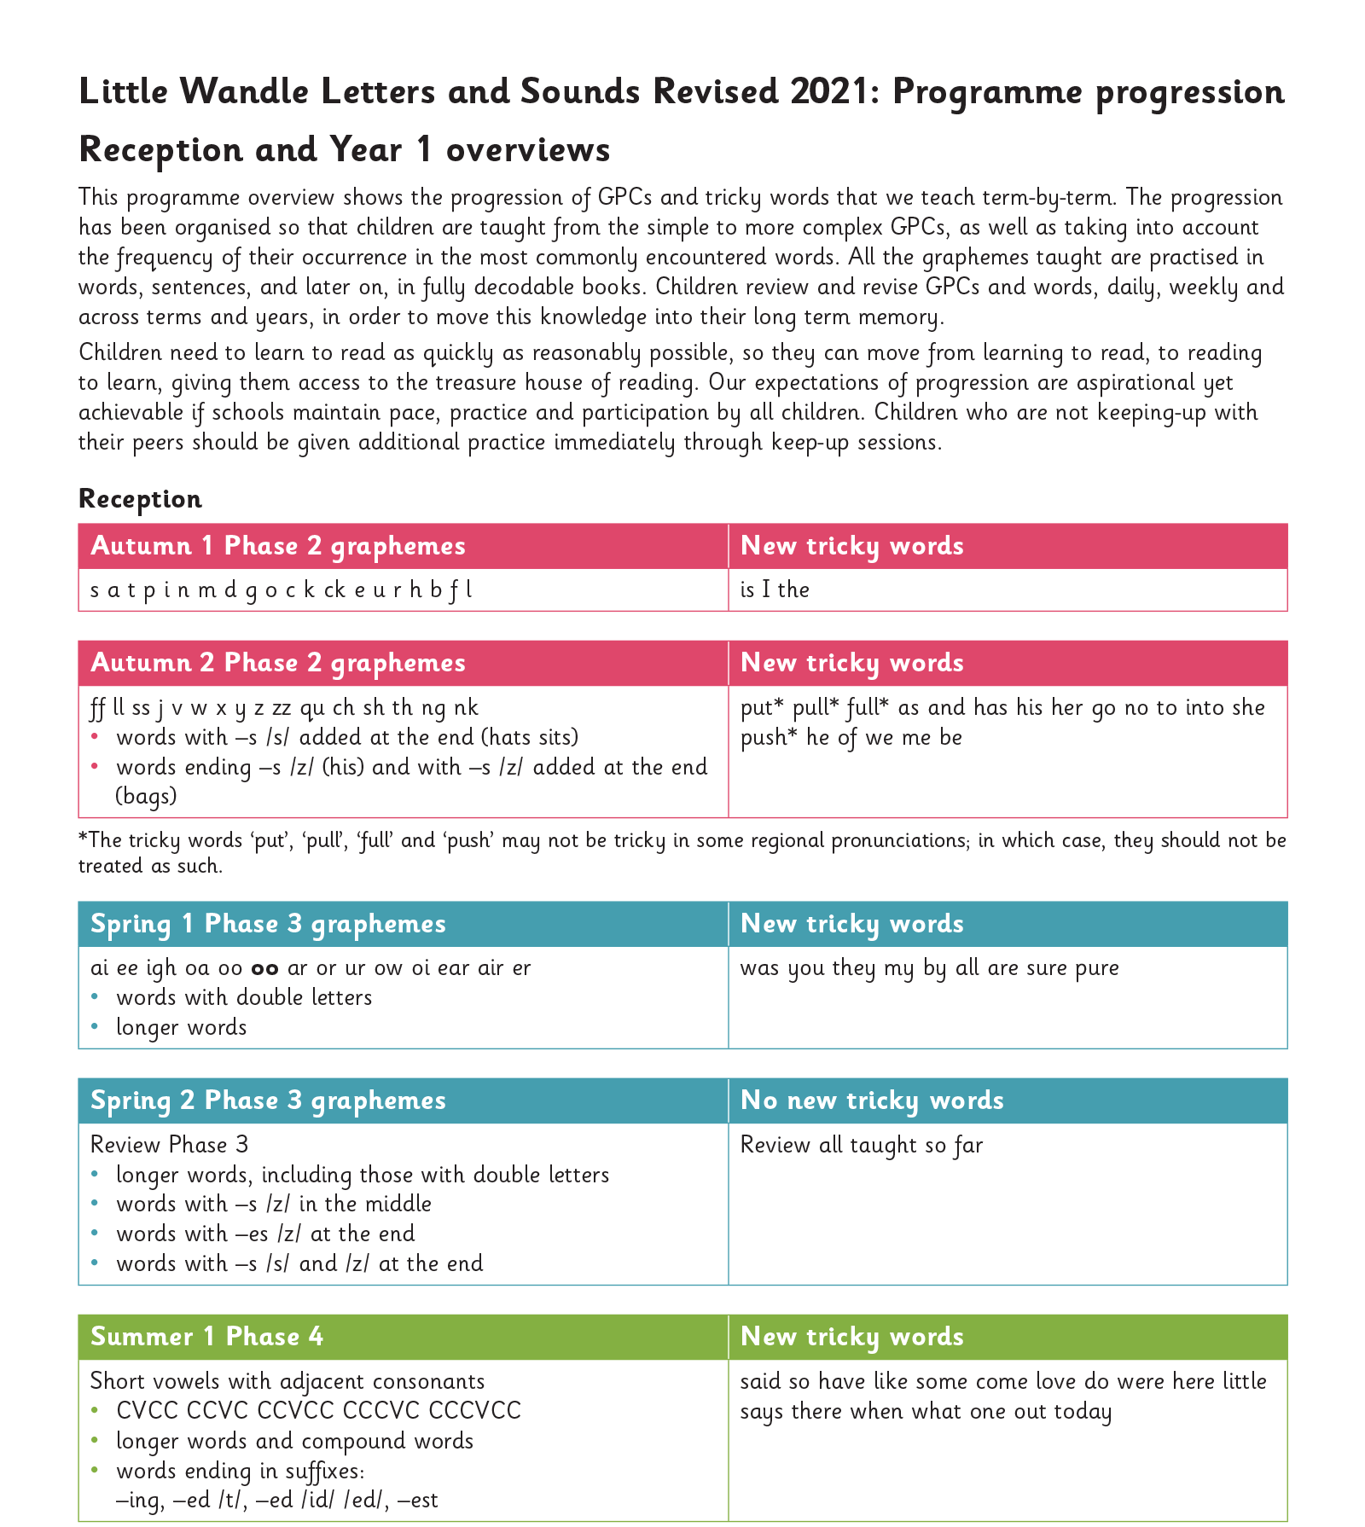
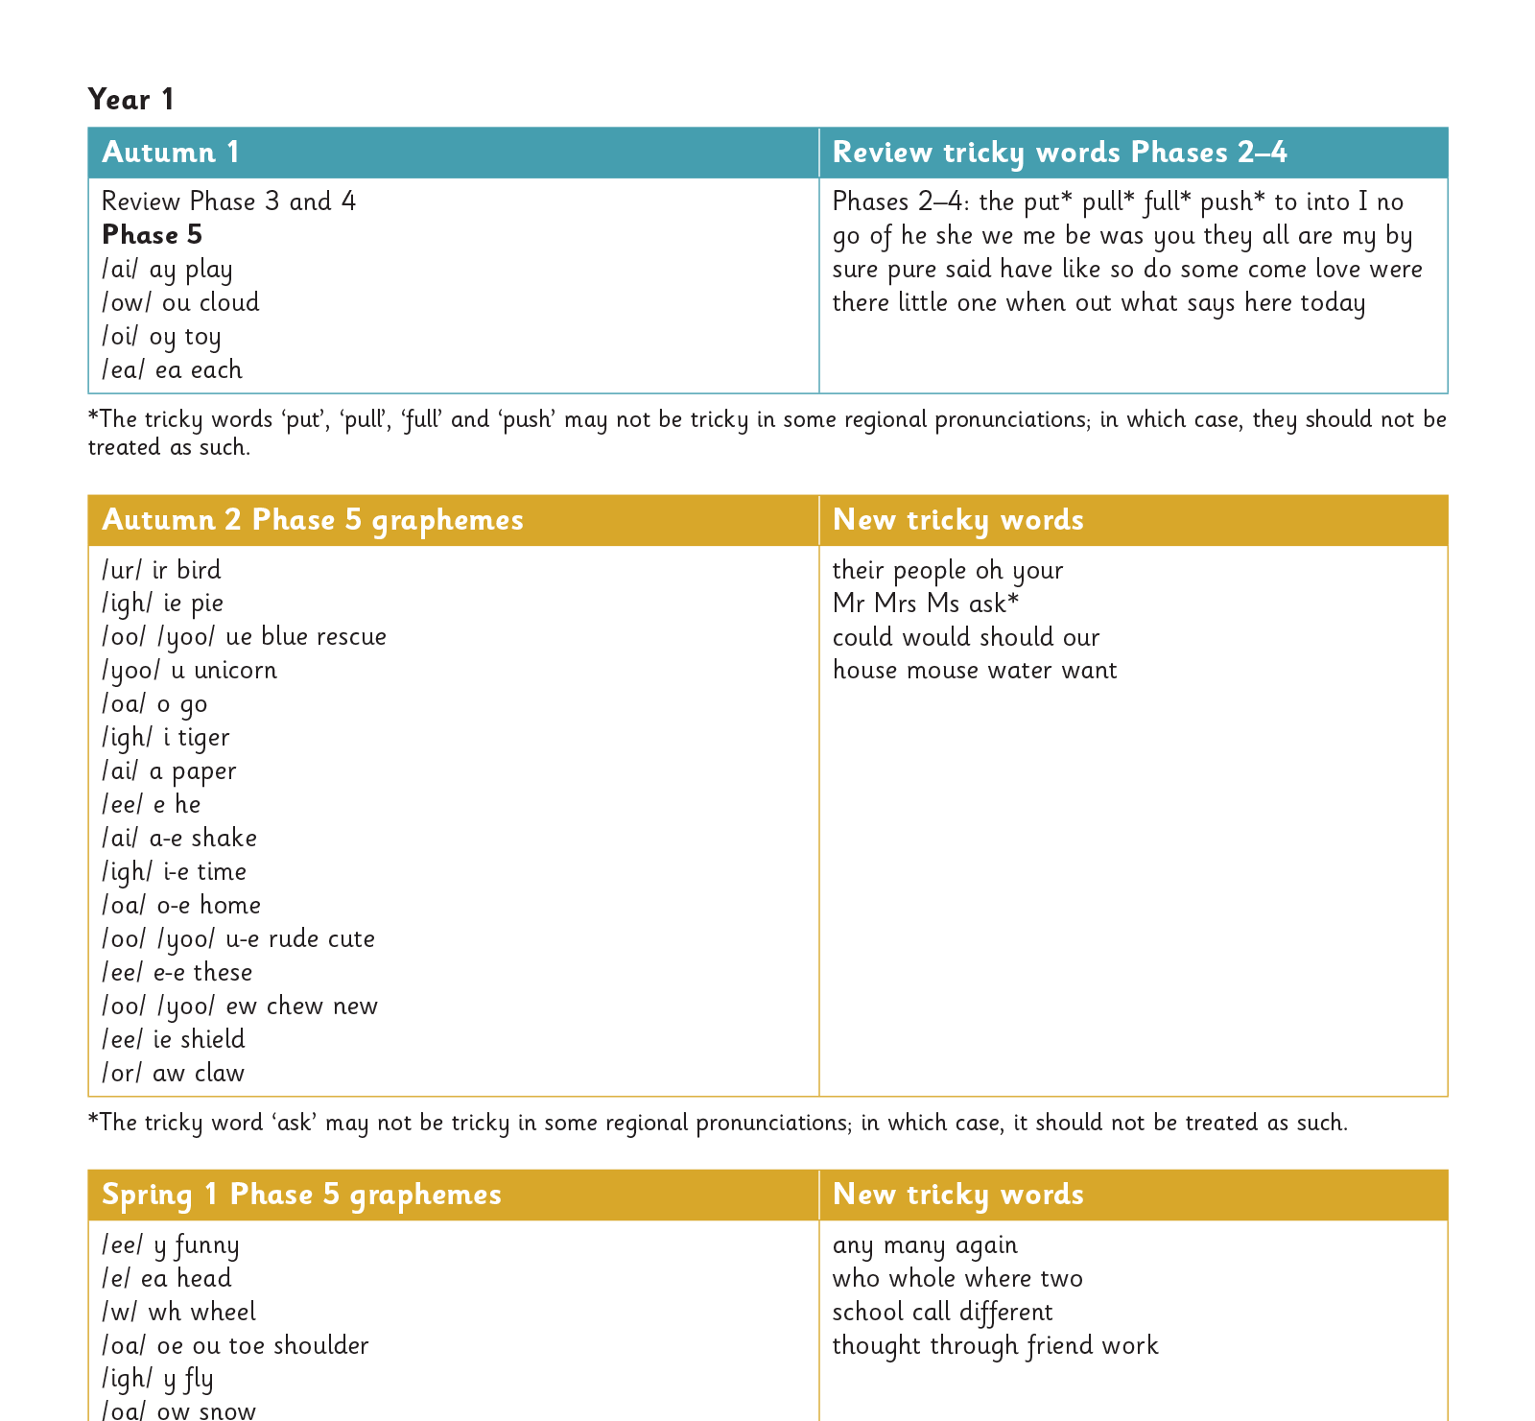
Gradually your child learns the entire alphabetic code:
Notes:
We will work our way through the whole Little Wandle Programme until your child can read fluently.

Slide 12
What might a Little Wandle lesson look like?
Mnemonic for each grapheme
A phrase that helps children produce the pure sound .
A formation phrase that helps children to learn the letter formation.
Speedy sounds flash cards
Oral blending
Teacher led blending
Decodable books sent home
Will contain words made up of sounds your child has been exposed to
Should be able to read independently

Slide 13
Terminology
Phoneme- the smallest unit of spoken sound in a word
Grapheme- a written symbol that represents a spoken sound
Digraph/trigraph- two letters that make one sound/ three letters that make one sound (action)
Encoding- the process of hearing a sound and being able to write a symbol to represent that sound
Decoding -seeing a written symbol and being able to say what sound it represents
Blending- involves pulling together individual sounds or syllables within words (reading)
Segmenting- involves breaking words down into individual sounds or syllables (writing)
Ascender- the part of a lowercase letter (such as b) that rises above the main body of the letter
Descender- the part of a lowercase letter (such as p) that descends below the main body of the letter
Notes:
There’s a lot of terminology surrounding phonics which our children learn to use…
Phoneme – smallest unit of sound r-ai-n
Grapheme- written representation of a sound
Digraph- 2 letters making one sound
Trigraph – 3 letters making one sound
Split digraph- still 2 letters making one sound but with other letters in between
Segment – (spelling) orally split a word into its phonemes (on fingers)
Blend- reading a word by saying the sounds in order
(See handout- this vocabulary can help you support your child at home eg- can you see a digraph? When reading and stuck on a word)

Slide 14
Pure Sound
Pronouncing each letter sound clearly and distinctly without adding additional sounds to the end e.g. ‘f’ not ‘fuh’.
Changing the way a word sounds:
Chat may become chatuh
Or worse,
Sun may become suhuhnuh
You try- train, sip, clock
The pure sounds can be found on Little Wandle Parents page

Slide 15
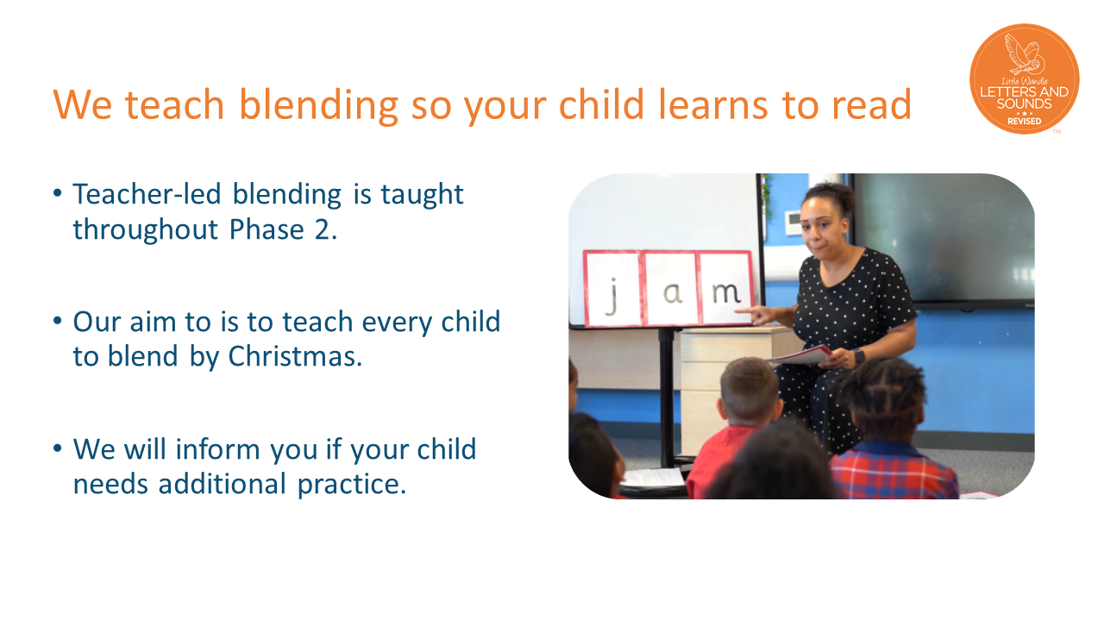

Slide 16
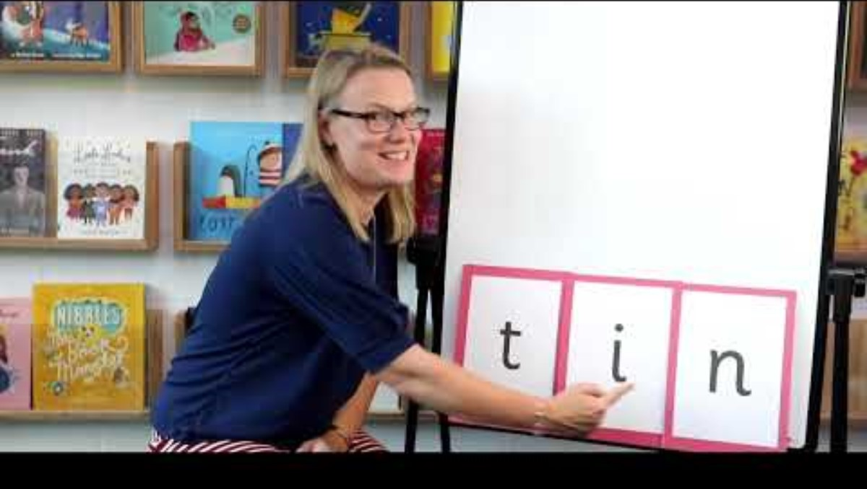
Blending to read words
Notes:
Some children learn to blend really quickly, and others take a little longer. If your child is finding it difficult, ask your child’s teacher for ways to help at home – playing blending games at home is so helpful!
Show parents this video from the website: https://www.littlewandlelettersandsounds.org.uk/resources/for-parents/

Slide 17
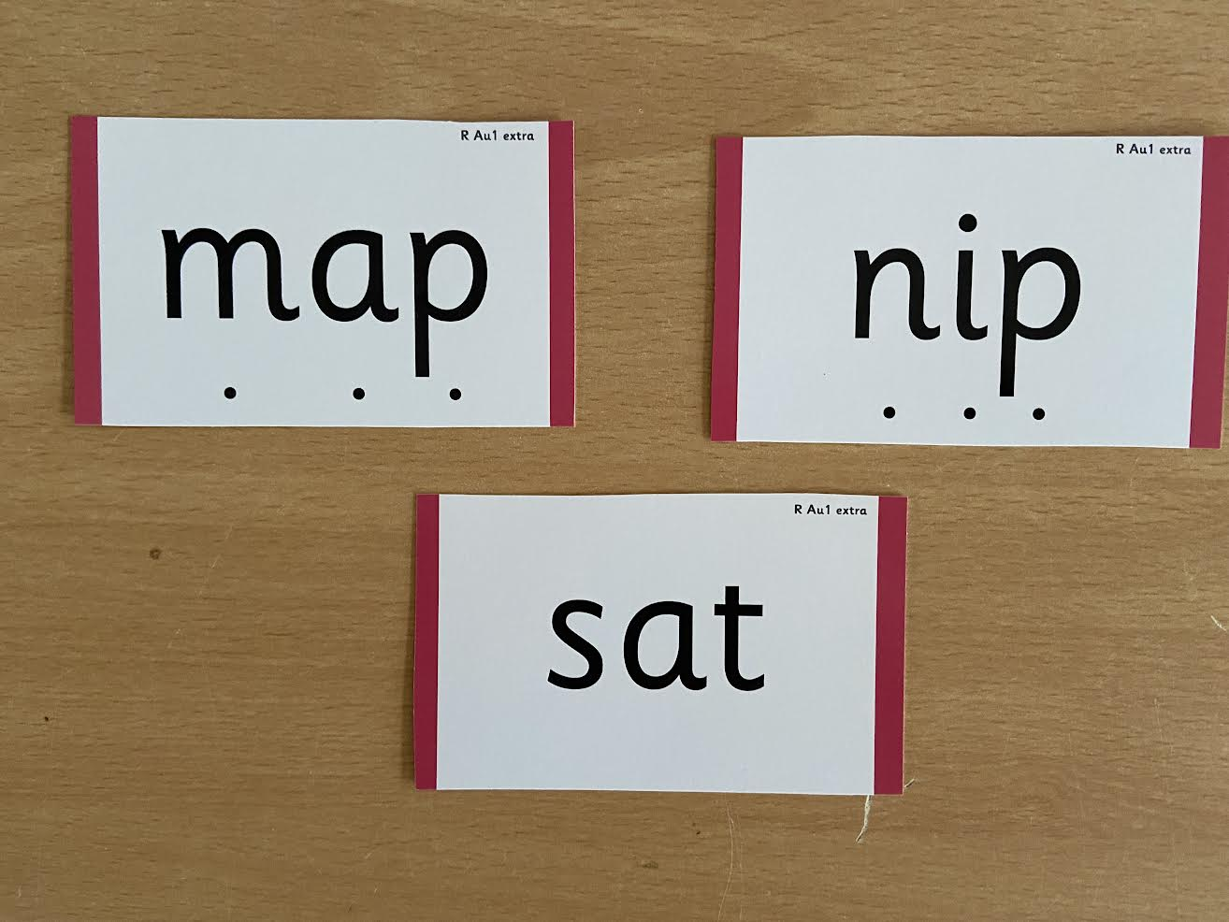
Use of sound buttons
Children begin by learning VC- it, CVC- cat
VCC- ant, CVCC- lamp, CCVC- blip, CCCVC- split, CCVCC- spent
You try: back, high, clip, milk
Notes:
We use sound buttons to help the children recognize sounds in words and then blend them together to read them.

Slide 18
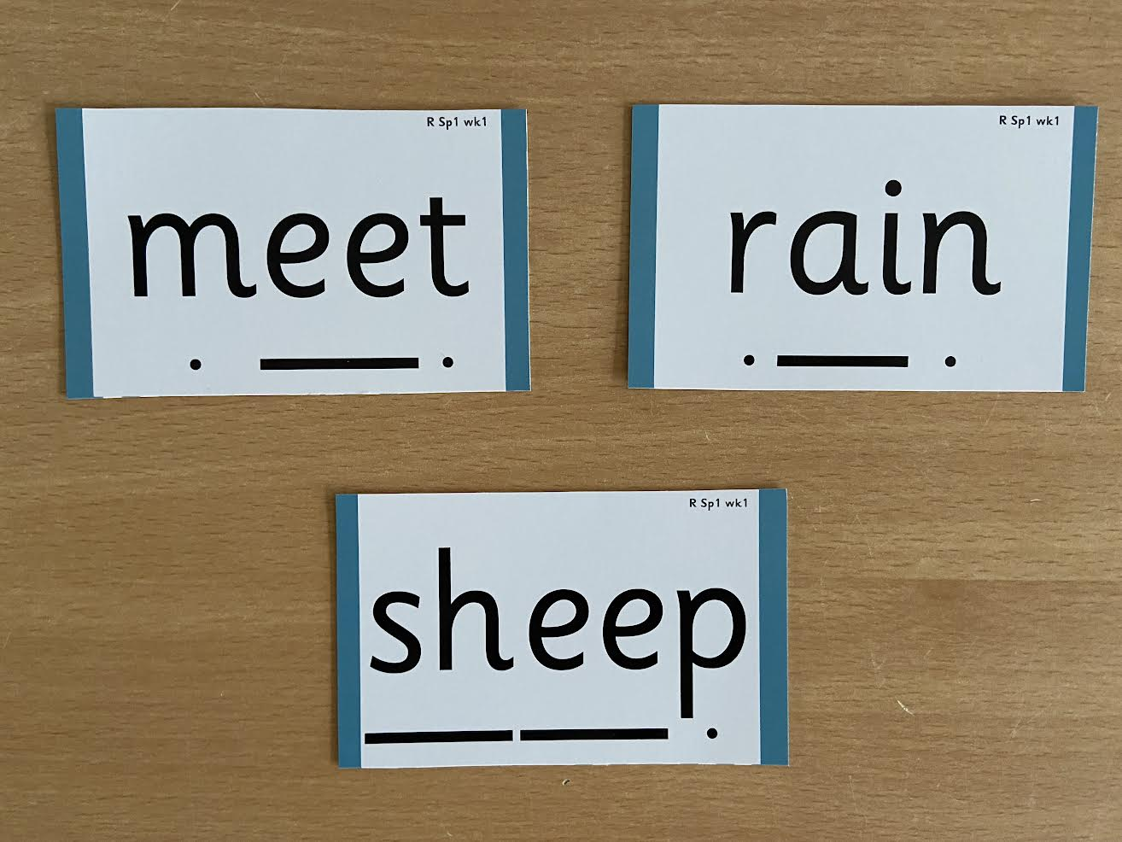
Use of sound buttons
Notes:
Model with children (list of words on a chart page)

Slide 19
Misonceptions
‘Magic e’ -there is no magic when it comes to spelling.
It is a split digraph eg o-e.
It is part of the sound family ‘oe’.
oe as in toe, o-e as in cone, oa as in goat, ow as in row.
Long and short vowel sounds
Any sound can be pronounced in a long or short way. We refer to them as vowels and vowel digraphs.
Silent letters
There are no silent letters. Letters we may think of as silent are part of a digraph eg in knock the kn is part of the n family, the ck is part of the c family.

Slide 20
Reading and spelling

Slide 21

Reading
We want children to love reading
Learning to read should be a positive experience
Reading should be enjoyable
We want children to read for pleasure
Reading underpins children’s access to the curriculum and clearly impacts on their achievement

Slide 22
How do we teach reading in books?
Reading practice sessions
Every child reads 2/3 times a week
taught by a trained teacher/teaching assistant
taught in small groups

Slide 23
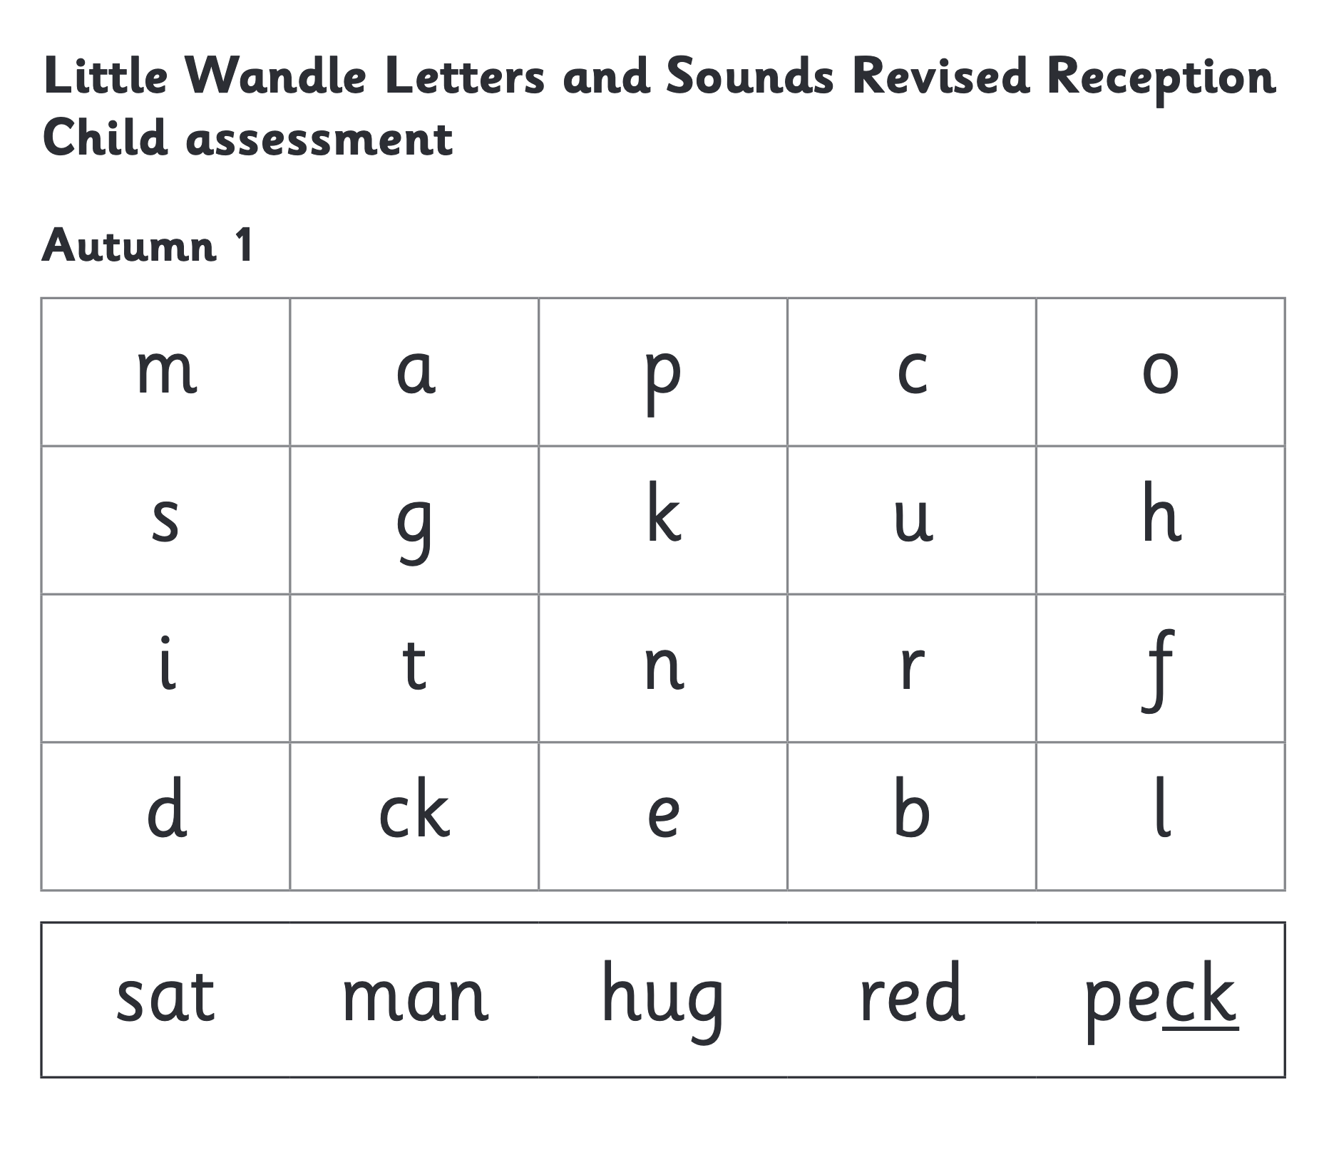
We use assessment to match your child the right level of book
We are aiming for 95% accuracy!
Notes:
We use half termly phonics assessments to match children to the right level of book. Groups are fluid so we move children as and when we need to.

Slide 24
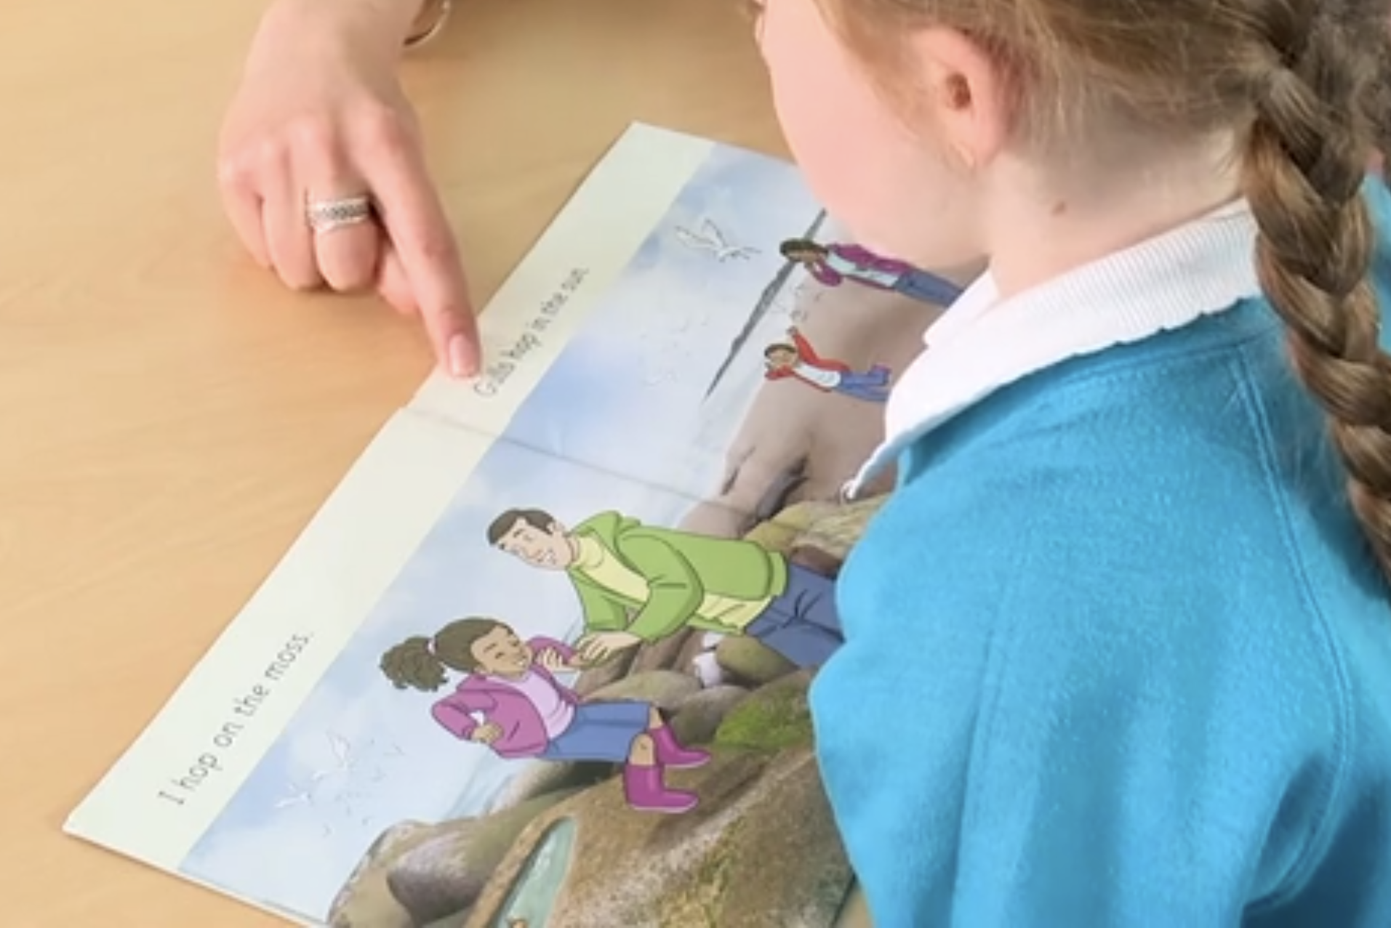
Reading a book at the right level
This means that your child should:
Know all the sounds and tricky words in their phonics book well
Read many of the words by silent blending (in their head) – their reading will be automatic
Only need to stop and sound out about 5% of the words by the time they bring the book home – but they should be able to do this on their own.

Slide 25
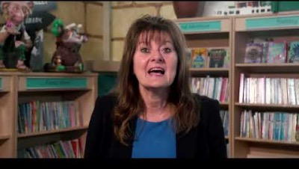
Tricky words

Slide 26

Spelling (segmenting)
Say it
Stretch it
(tap it)
Segment it
Count the sounds
Write them down
Notes:
Model with children – we have visuals in the classroom for the children to use if they forget what a sound looks like.
Boat
waiting

Slide 27
Reading at home

Slide 28

The most important thing you can do is read with your child
Studies show reading a book and chatting about it had a positive impact a year later on children’s ability to…
understand words and sentences
use a wide range of vocabulary
develop listening and comprehension skills
The amount of books children were exposed to by age 6 was a positive predictor of their reading ability two years later.
Parental involvement in the development of children’s reading skills: A five-year longitudinal study (2002) Senechal, M. and Lefvre, J

Slide 29
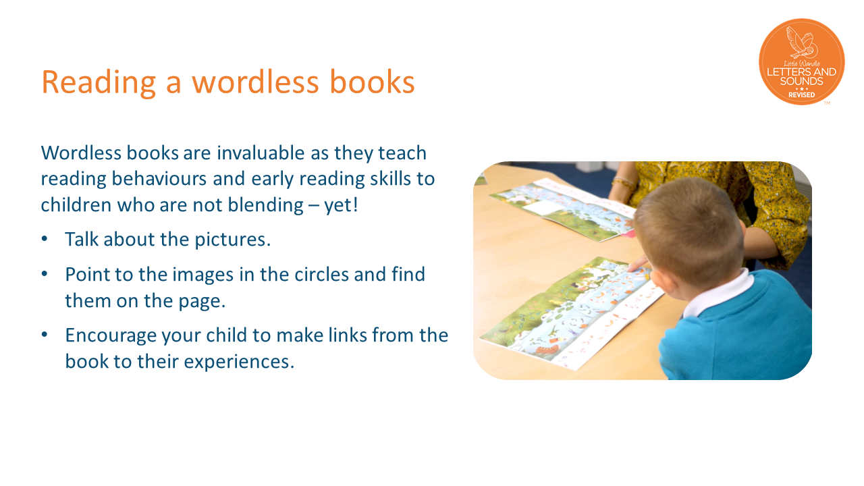

Slide 30

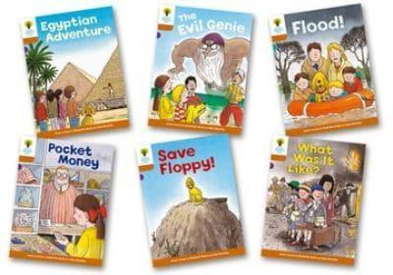
Books going home
Sharing book – non decodable to share with your child (but there will be words they can read)
Phonetically decodable e reader
Library book to share with your child
Notes:
As well as the ‘learning to read’ book that your child will bring home they will also bring home a book for sharing with you. This book is SO important. This is how we are going to give them the WILL to read. Please read with your child as often as you can – at least once a day if possible.

Slide 31
What about words that can’t be read easily with phonics?
Some common words are unusual and do not make sense with phonics until much later in your child’s reading journey, for example, ‘was’ and ‘the’.
We call these words ‘tricky words’ and we teach these words differently. We help children to identify the bit that does make sense and the part that is tricky.
The ‘Phase 2 tricky words’ document provides more information. You will find this in the ‘For parents’ area of the Little Wandle website. What can I do to support my child at home? / link on our website
Ask them what sounds they have learned each day and point out objects in the environment or in books that start with that sound.
Read to your child daily – choose books that you can enjoy together. The love of reading books we send home are a great place to start!
Listen to them practise reading their phonics book to develop their fluency. •

Slide 32
Listening to your child read their phonics book
These are phonetically decodable books that are matched to your child's phonic knowledge.
The book allocated to your child on a Friday is what they have been reading that week in school.
Your child should be able to read their book without your help.
1-1 reading use a technique called: Teaching through miscues.
Don’t give all the answers or correct a child too quickly.
Decoding should be seen as problem solving. You give children the bits of information and let them solve the problem.
Don’t repeat the incorrect word eg ‘it’s not …’ focus on the information they need to make it right.
Misses out a sound in a word when reading.
Child reads split as spit.
I am eating a banana split.
You say, ‘Lets look at that again. If this was spit this wouldn’t be here (point to l). Say it again with this sound in.’
Ask questions about what they have read and give them lots of praise.

Slide 33
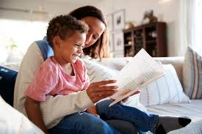
Share with your child
These ARE NOT properly matched to what the children have learnt in phonics but the children really enjoy the stories and the characters. They often have some sounds/tricky words a child has not been taught yet so they may need more help with these than a like for like colour LW book.
Encourage your child to predict and retell
Ask them questions about the book

Slide 34

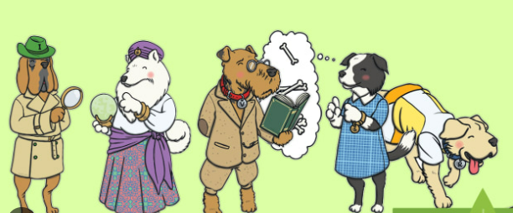
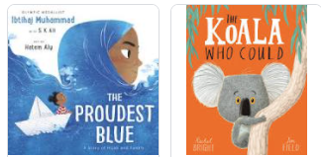
Read to your child
The Library book is for YOU to read to your child:
Make the story sound as exciting as you can by changing your voice.
Talk with your child as much as you can:
  Predict what they think might happen
  Talk about the meaning of new vocabulary
  Describe things you see
  Talk about the story and characters
  Ask your child lots of questions- both literal and inferential

Slide 35
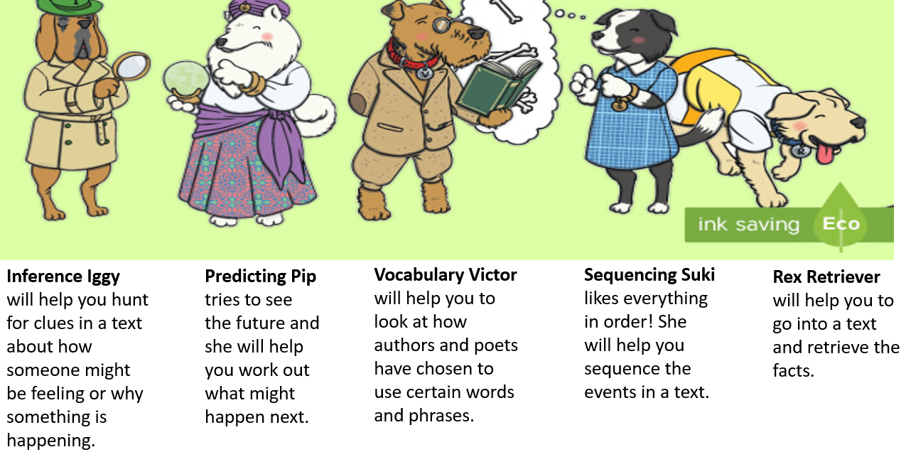
Reading skills

Slide 36

Vocabulary
Vocabulary is the knowledge of words and word meanings.
It is important to develop vocabulary because:
- It provides a strong foundation for school activities
- It helps build confidence
- It enables children to communicate their needs better (and therefore reduces frustration)
- It facilitates the development of friendships
It helps children make sense of the world around them
How can I help?
When reading point out unfamiliar words and discuss the meaning of them.
Make conversation a priority and explain new vocabulary when it arises.
Play word games such as ‘what am I?’ or ‘unknown story’.
Don’t ‘dumb it down’ when you talk to children.

Slide 37
Word Wallets
Your Child’s word/sound wallets contain the graphemes and tricky words your child has learnt
Please practise holding the grapheme up and wait for your child to say the phoneme
Use the sounds in the wallet to play games
Please ensure word wallets remain in your child’s book bag so we can add more sounds.

Slide 38

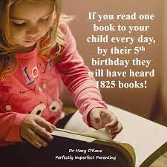

Slide 39
One of the greatest gifts adults can give is to read to children
Carl Sagan
Notes:
Thank you for coming. Please remember to take a hand out.
Any questions?

